Slide 1
Data science

Slide 2
Introduction
Today Data science is famously known as the top rated field in developed countries (USA ,EU ,China)
It is considered as a sub-field of computer science and engineering
It can require an additional specialization and experience
Recently data can leverage several important businesses including medical and financial side

Slide 3
Why data is important ?
It can improve people lives
Make informed decision
Data
Find solution to problems
Great understanding of any situation

Slide 4
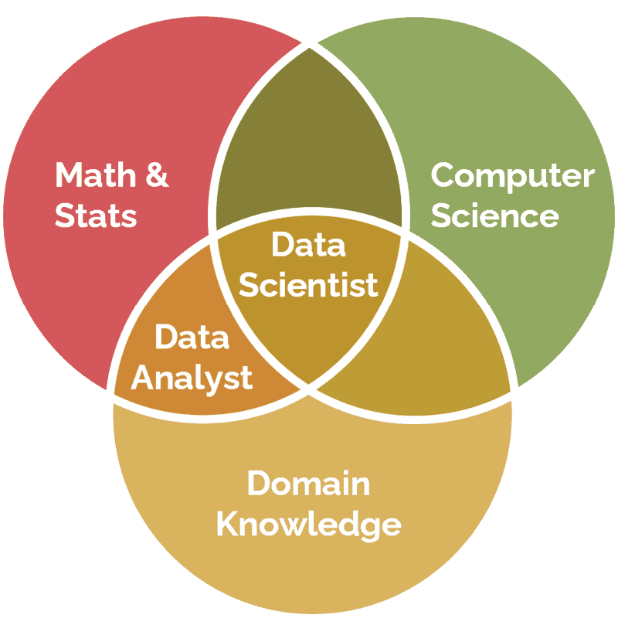
Who is data scientist ? And what is his main role within company ?
Collect data and identify data sources
Analyze structured and unstructured data
Create solution to business problems
Work in collaboration with team member
Discover trends and patterns
Present data using various data visualization tools and technics

Slide 5
The main required soft and hard-skills in data science ?
Data scientist
Soft-skills
Hard-skills
ML/DL
Python programming
SQL
R
Excel
Statistics
Logical reasoning
Teamwork
Critical thinking
Detail orientation
Communication skills

Slide 6
Conclusion

